Slide 1

Course Project
Mohamed mostafa 202000484
Nour Mohamed
202000119
Abdelrhman hossam
202001458
Ahmed mostafa 202000896
Begad soliman
202001947
This Photo by Unknown Author is licensed under CC BY-NC

Slide 2
Problem Description
Robotic firefighting systems are designed with certain tasks in mind. These include analyzing and locating fires, conducting search and rescue, monitoring hazardous variables and the primary task of fire control and suppression. Fixed firefighting robotic systems are used in heavily populated and hazardous areas for rapidly extinguishing any threat.

Slide 3
The Problems We Faced
The Bluetooth was not working with the mobile app, so we connected it with the Arduino cable to the laptop and gave it commands with the serial monitor.

Slide 4
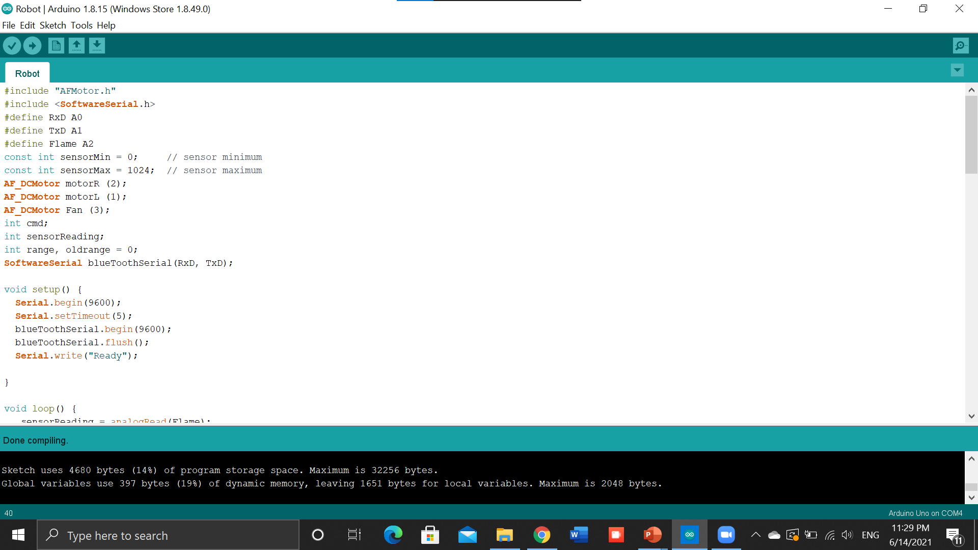

Slide 5
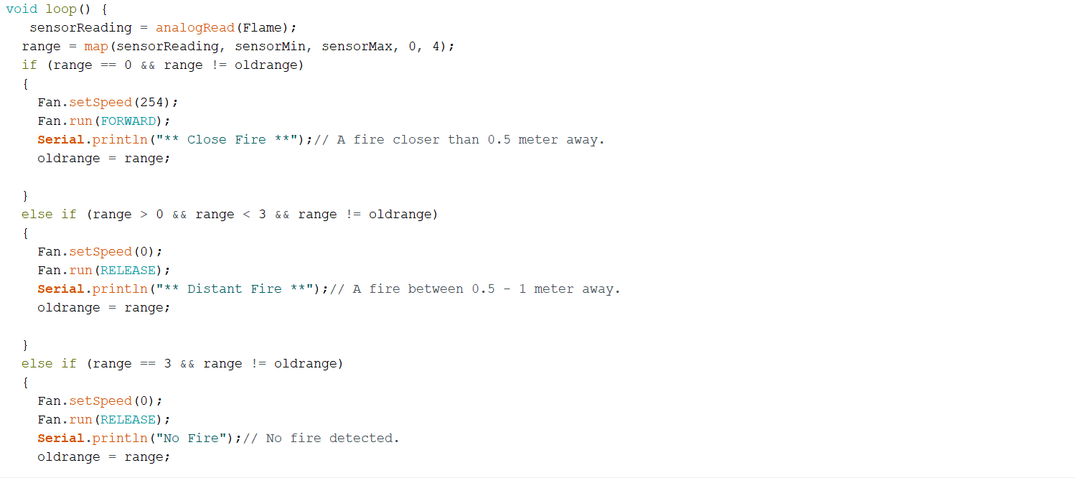

Slide 6
Main components
Arduino
Motor Shield
Lithium battery
flame Sensor
Computer Fan

Slide 7
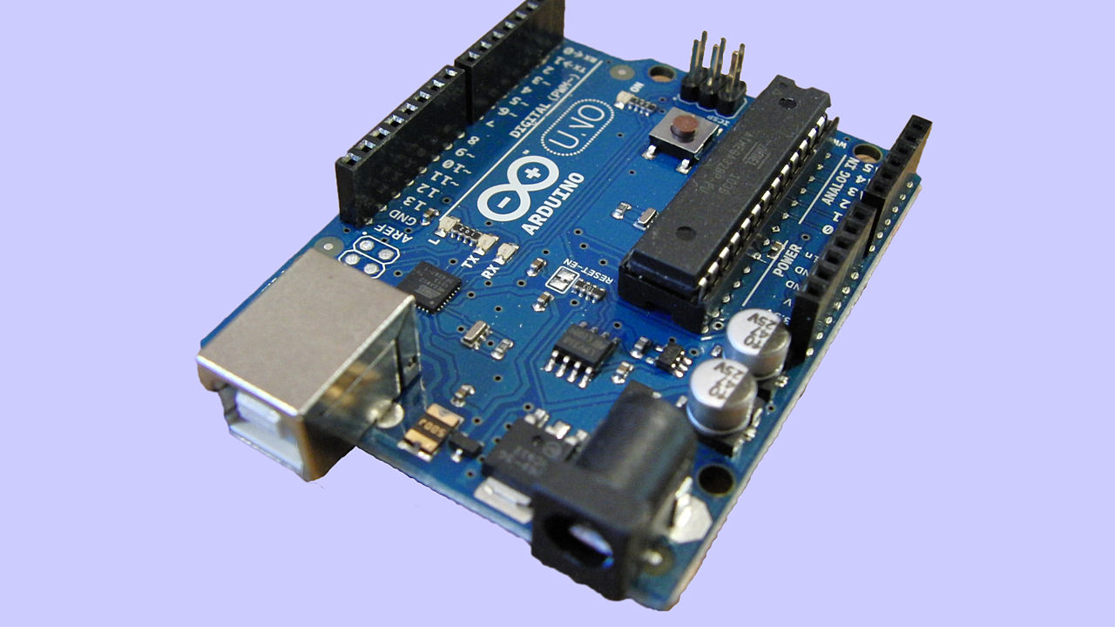
Arduino
It is a platform for artists, designers, and anybody interested in developing interactive objects or settings to make electronics more accessible. Because the hardware design is open source, an Arduino board may be purchased pre-assembled or made by hand.
This Photo by Unknown Author is licensed under CC BY-SA

Slide 8
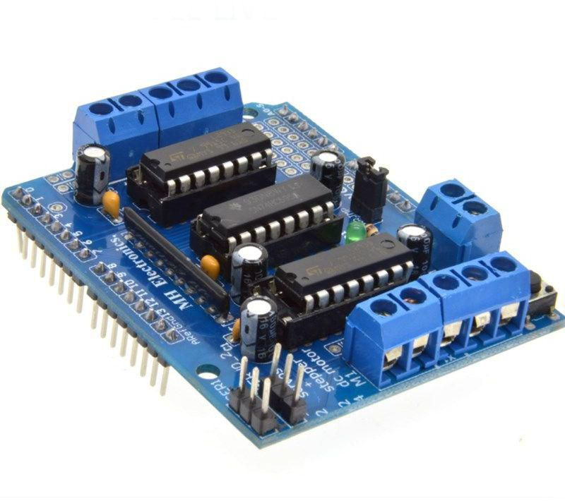
Arduino Motor Shield
The Arduino Motor Shield allows your Arduino to drive DC and stepper motors. It lets you drive two DC motors with your Arduino board, controlling the speed and direction of each one independently. You can also measure the motor current absorption of each motor, among other features.

Slide 9
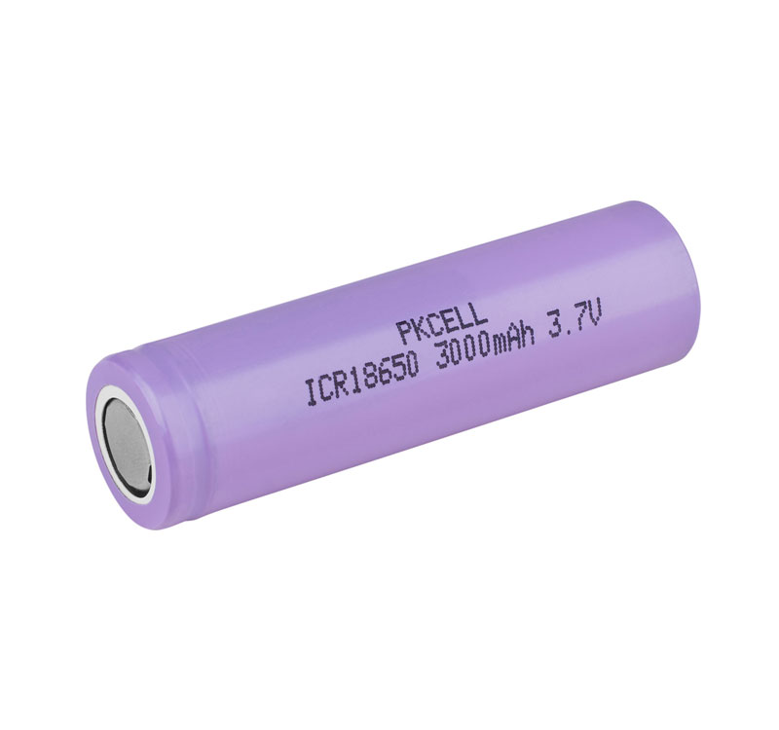
Lithium Battery
A lithium-ion battery or Li-ion battery is a type of rechargeable battery. Lithium-ion batteries are commonly used for portable electronics and electric vehicles and are growing in popularity for military and aerospace applications.

Slide 10
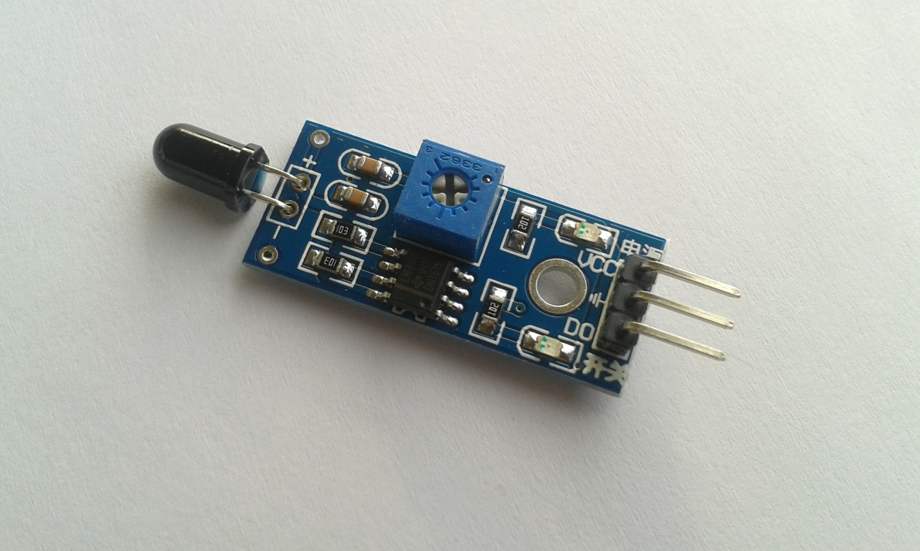
flame Sensor
The flame sensor is a kind of detector, which is mainly designed to detect and respond to the occurrence of fire or flame.
This Photo by Unknown Author is licensed under CC BY

Slide 11
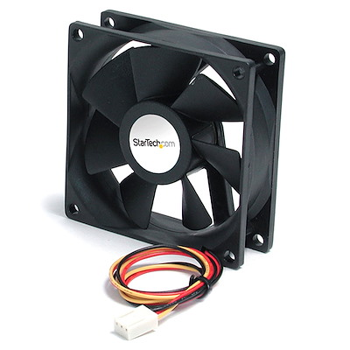
Computer Fan

Slide 12
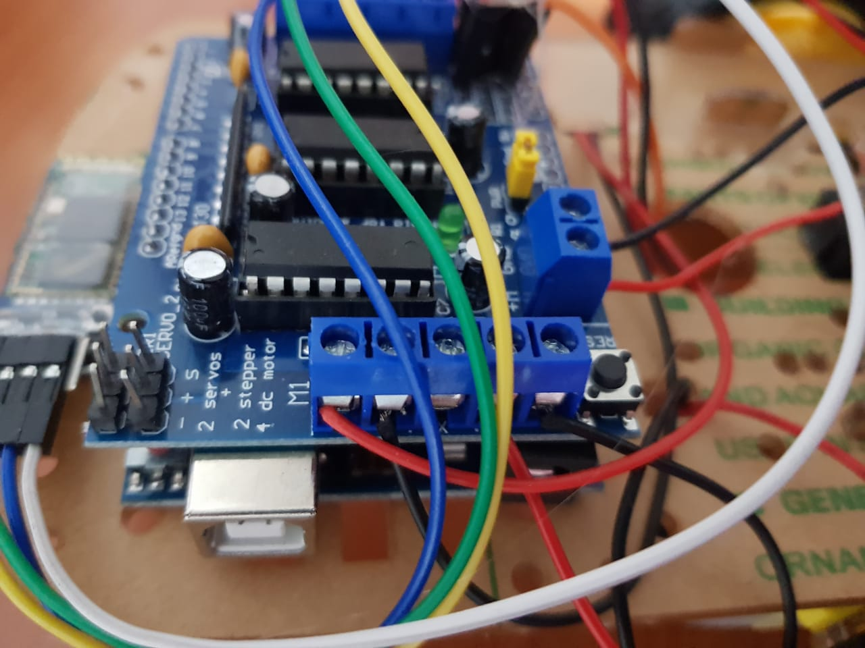
The left car motor is connected to motor 1 in the motor shield
The right car motor is connected to motor 2 in the motor shield

Slide 13
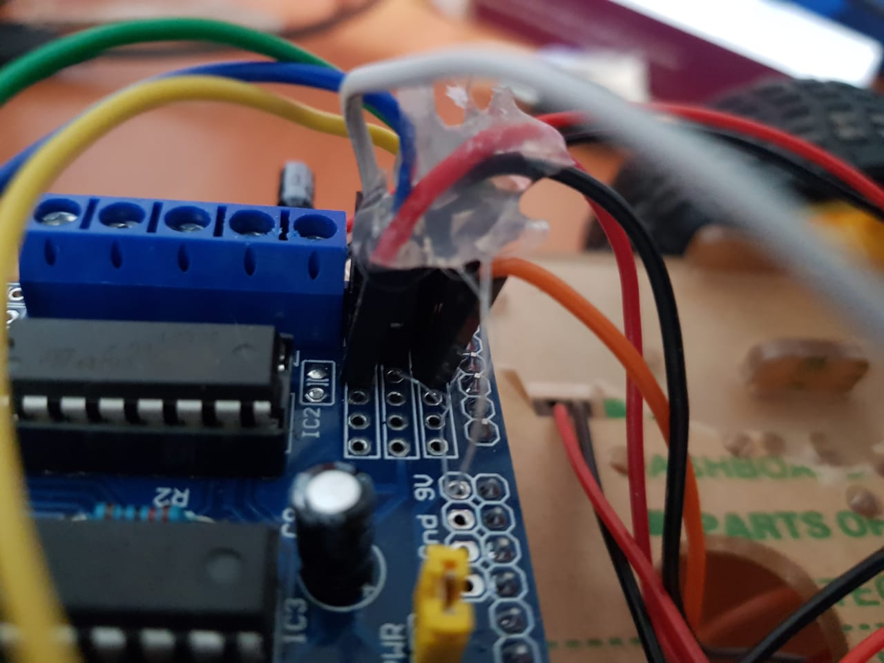
The Bluetooth Is connected in the motor shield :
The white cable is from the vcc in Bluetooth to vcc in motor shield
The blue cable is in the ground
The green cable TxD is connected to A1 in motor shield
The yellow cable is RxD is connected to A0 in the motor shield

Slide 14
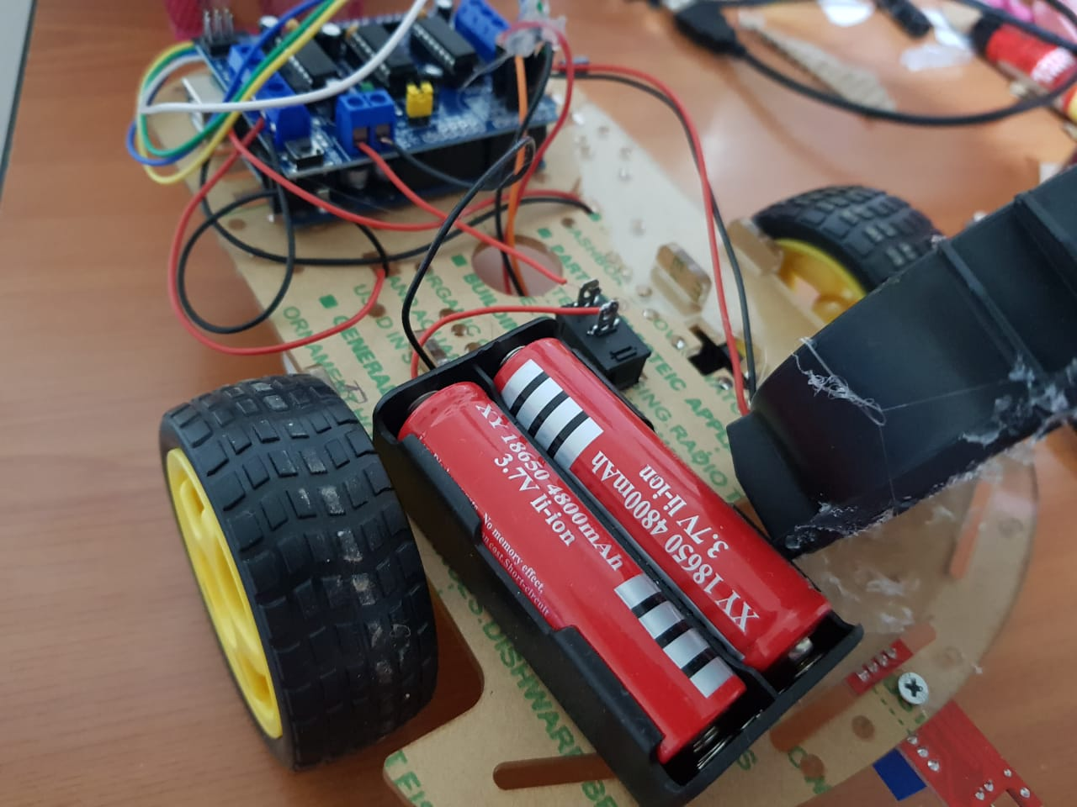
The negative cable in battery is connected to the negative in motor shield and the positive is connected to the button and there is a cable connected from the button to the positive in the motor shield.
The fan is connected to motor 3 in the motor shield and there is a capacitor parallel with it to increase the fan speed.

Slide 15
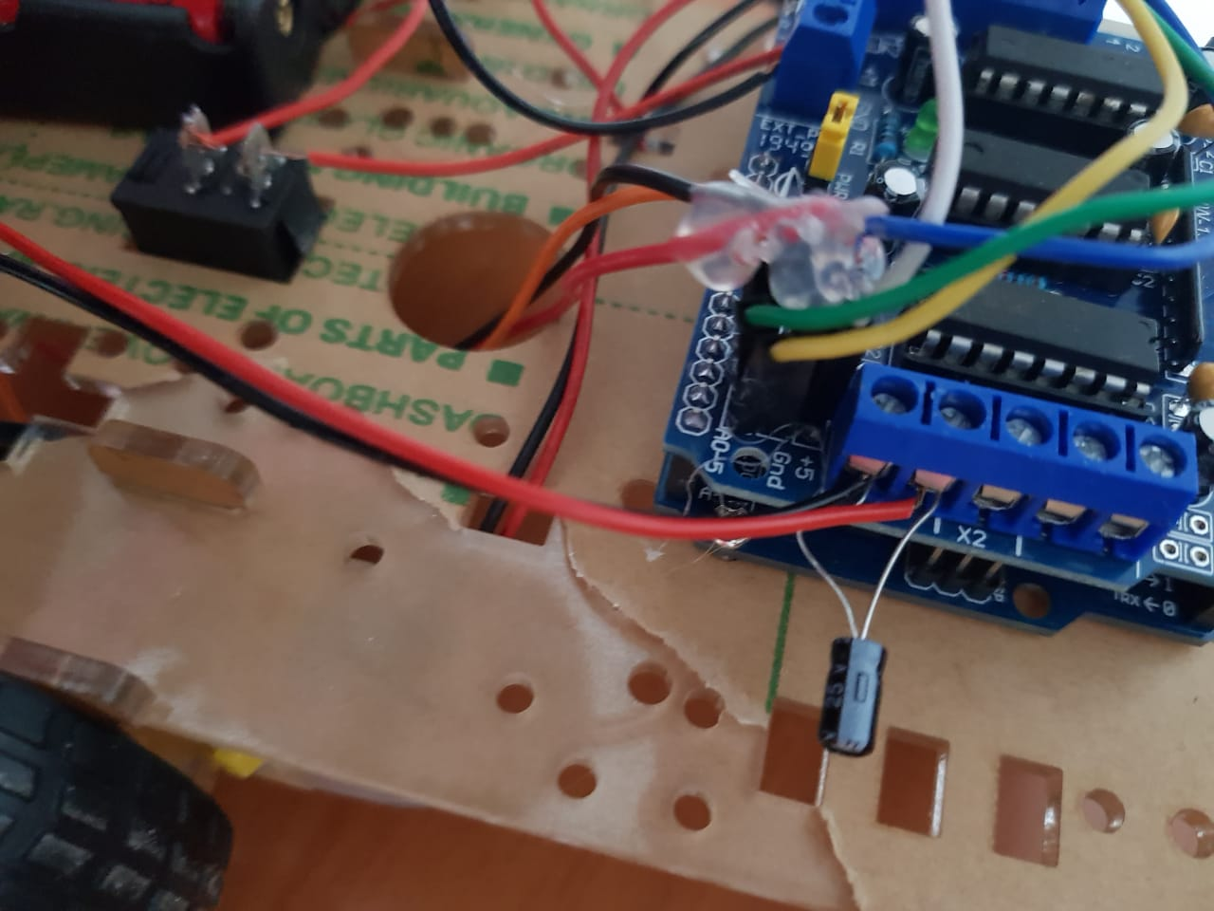
The capacitor is parallel in motor 3 with cables of the fan

Slide 16
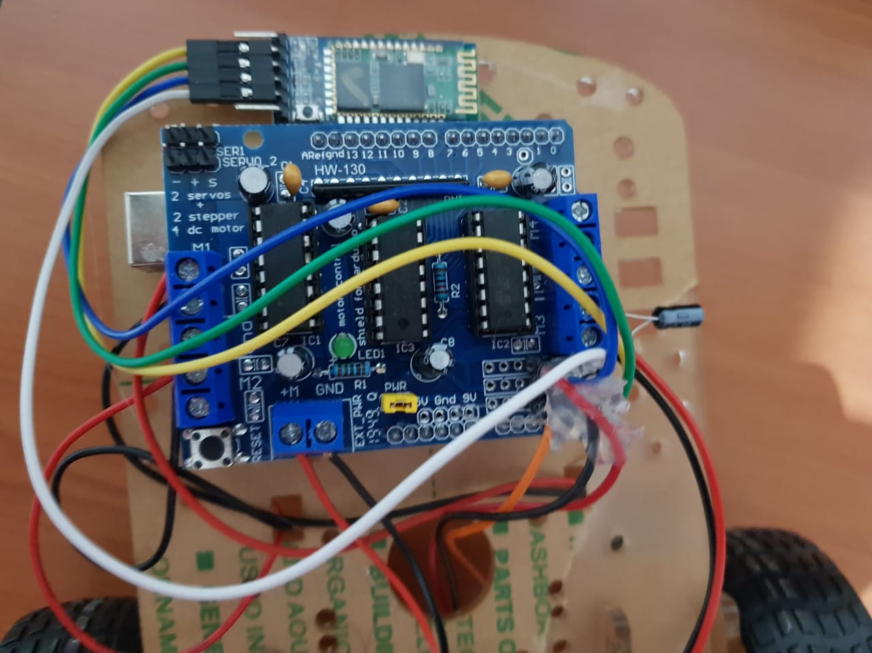
The sensor is connected to the cables orange red black that are coming from the bottom:
The red cable is the vcc connected in the motor shield in vcc
The black cable is the ground
The orange cable is the A connected to A2 in the motor shield

Slide 17
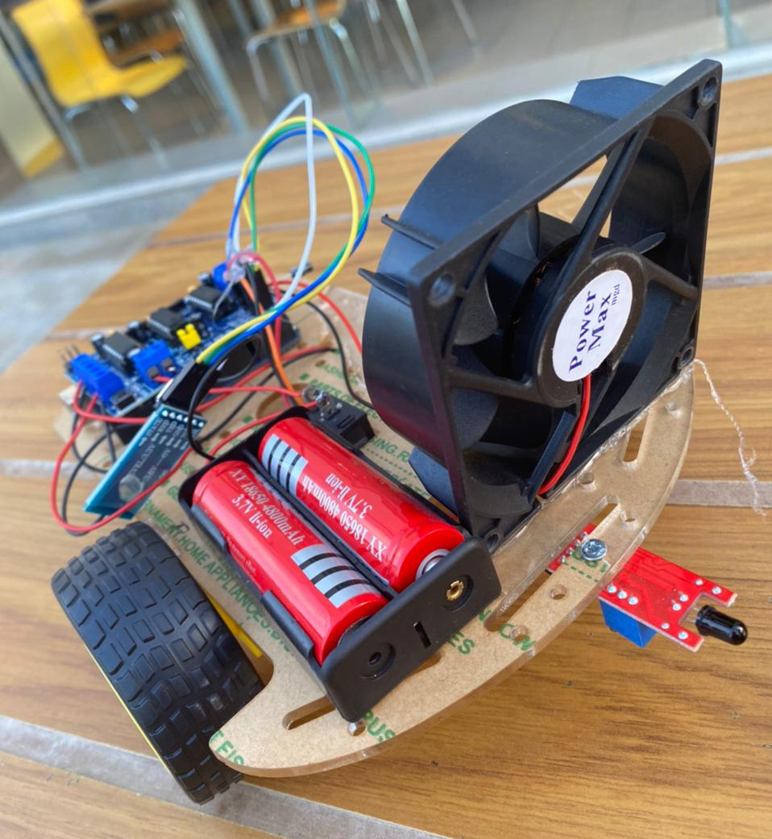

Slide 18
Future Work
We will try to find a solution for the Bluetooth, and we can develop the robot by adding another fan and more sensors. We can also higher the voltage by adding another battery.

